Slide 1

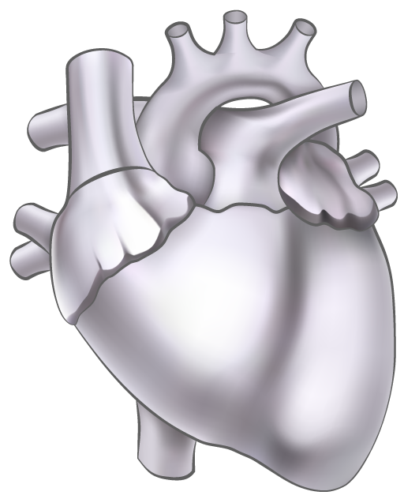
ECG Signal
Segmentation
Using Haar Wavelets

Slide 2
INTRODUCTION
Cardiac cells are electrically polarised.
There is some electrical activity associated with the heart beats.
ECG records this electrical activity.

Slide 3

01
ECG Signals

Slide 4
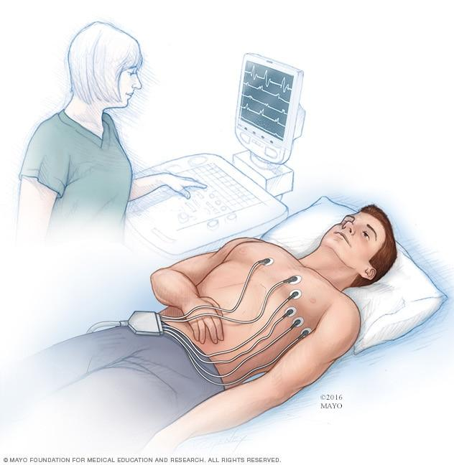
An ECG records the electrical activity of the beat , where each heart beat is displayed as a series of electrical waves characterized by peaks and valleys.
https://www.mayoclinic.org/tests-procedures/ekg/about/pac-20384983#dialogId65003744

Slide 5
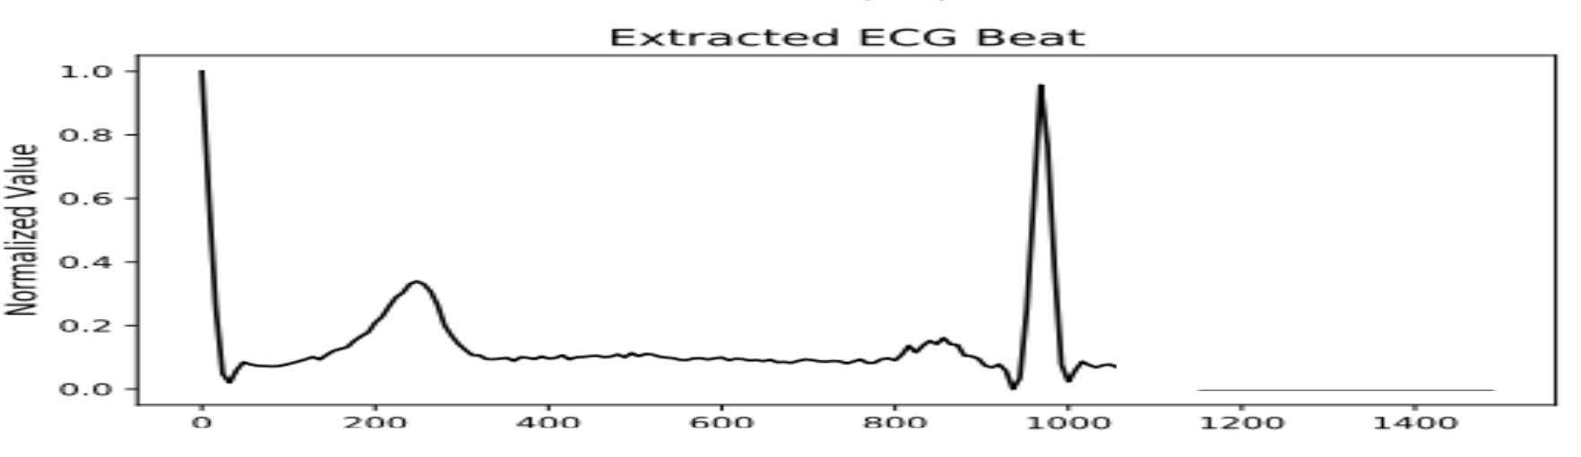
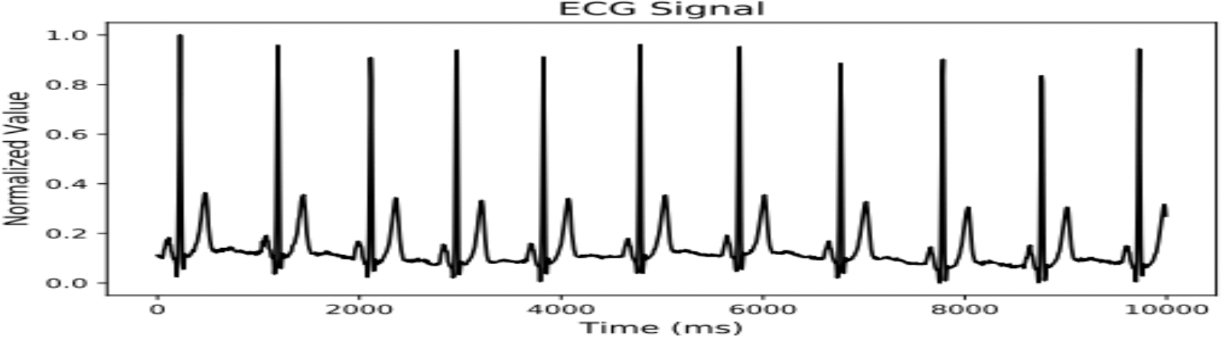
https://www.knime.com/blog/how-to-classify-ecg-signals-deep-learning

Slide 6
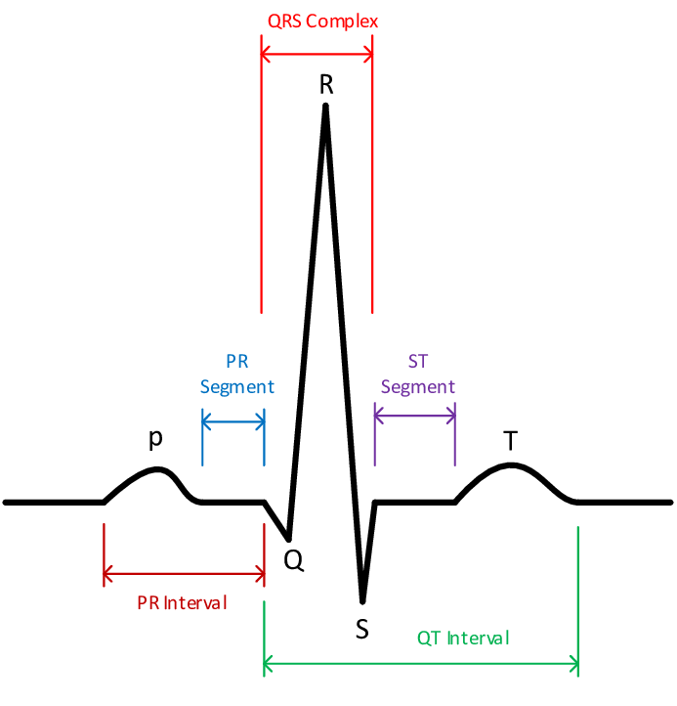
https://www.researchgate.net/figure/a-The-typical-ECG-beat_fig2_339884307

Slide 7

Different techniques have been used to segment ECG signals.
Let’s review a few of them..

Slide 8
Correlation Analysis
02
A. B. Ramli, and P. A. Ahmad, “Correlation analysis for abnormal ECG signal features extraction,” 4th National Conference on Telecommunication Technology, 2003.

Slide 9
The assessment of the similarity between two ECG samples x (n) and y (n) is carried out by calculation of cross-correlation.
The normal ECG signal is set as a reference signal and the others are grouped as a signal under test. Both the ECG signals will produce a different magnitude and shape, by using the correlation function.

Slide 10
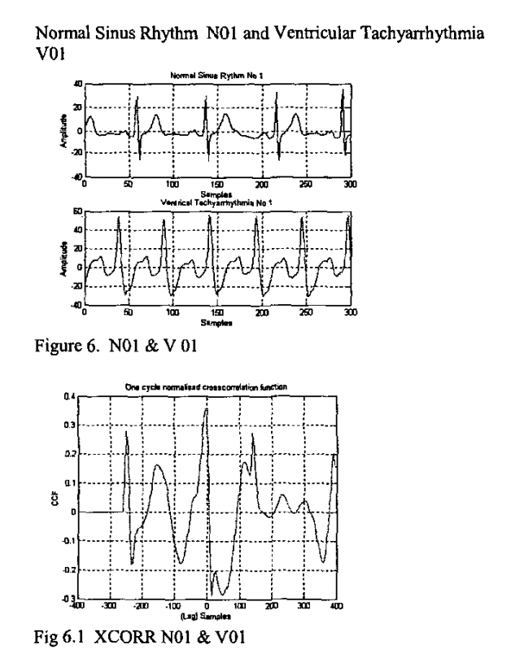
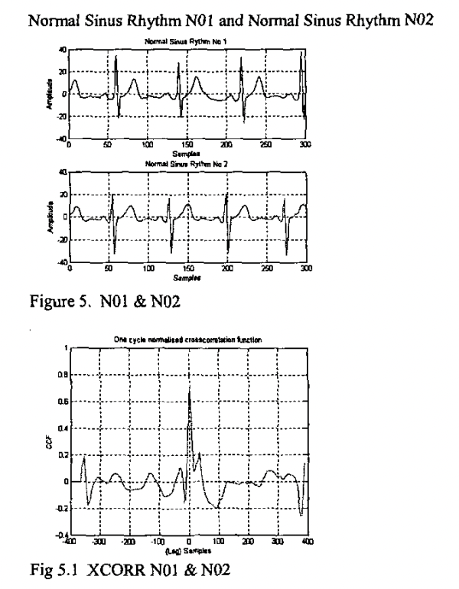

Slide 11
LIMITATIONS
Algorithm tested for only two types of diseases: Arrhythmia and Ventrical Tachyarrythmia.
Accuracy obtained is only 92%.

Slide 12
Linear Regression Algorithm
03
Aspuru J, Ochoa-Brust A, Félix RA, Mata-López W, Mena LJ, Ostos R, Martínez-Peláez R. Segmentation of the ECG Signal by Means of a Linear Regression Algorithm. Sensors (Basel).

Slide 13
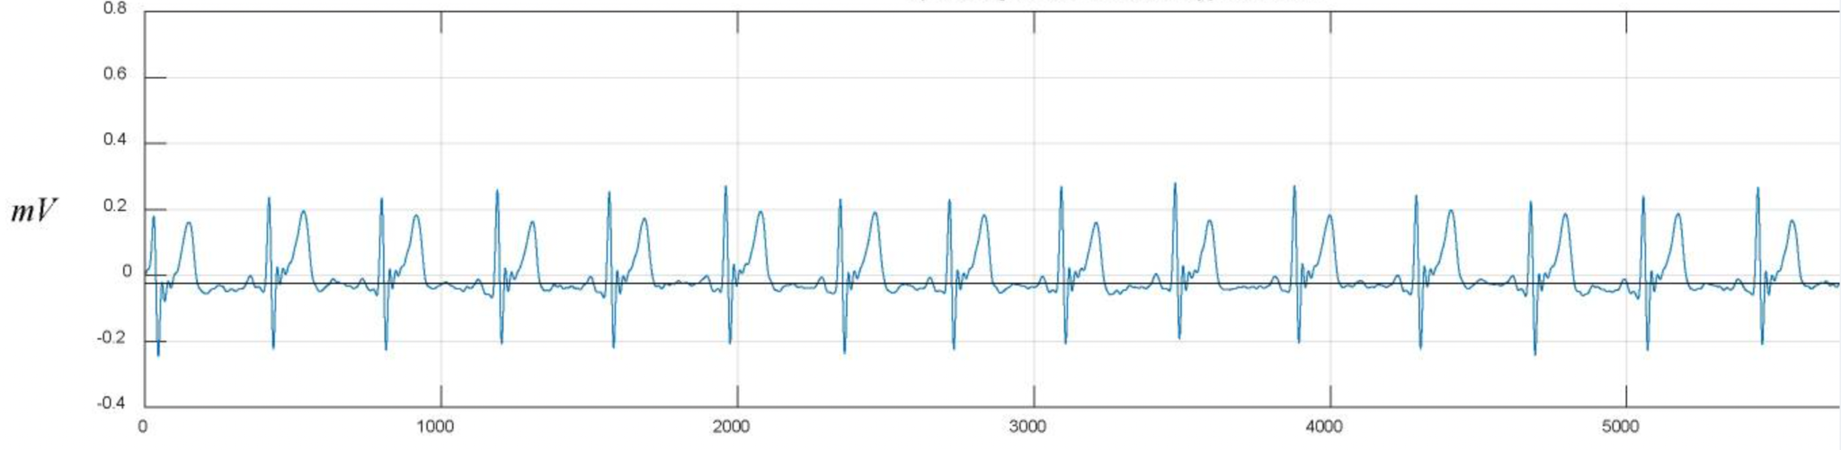
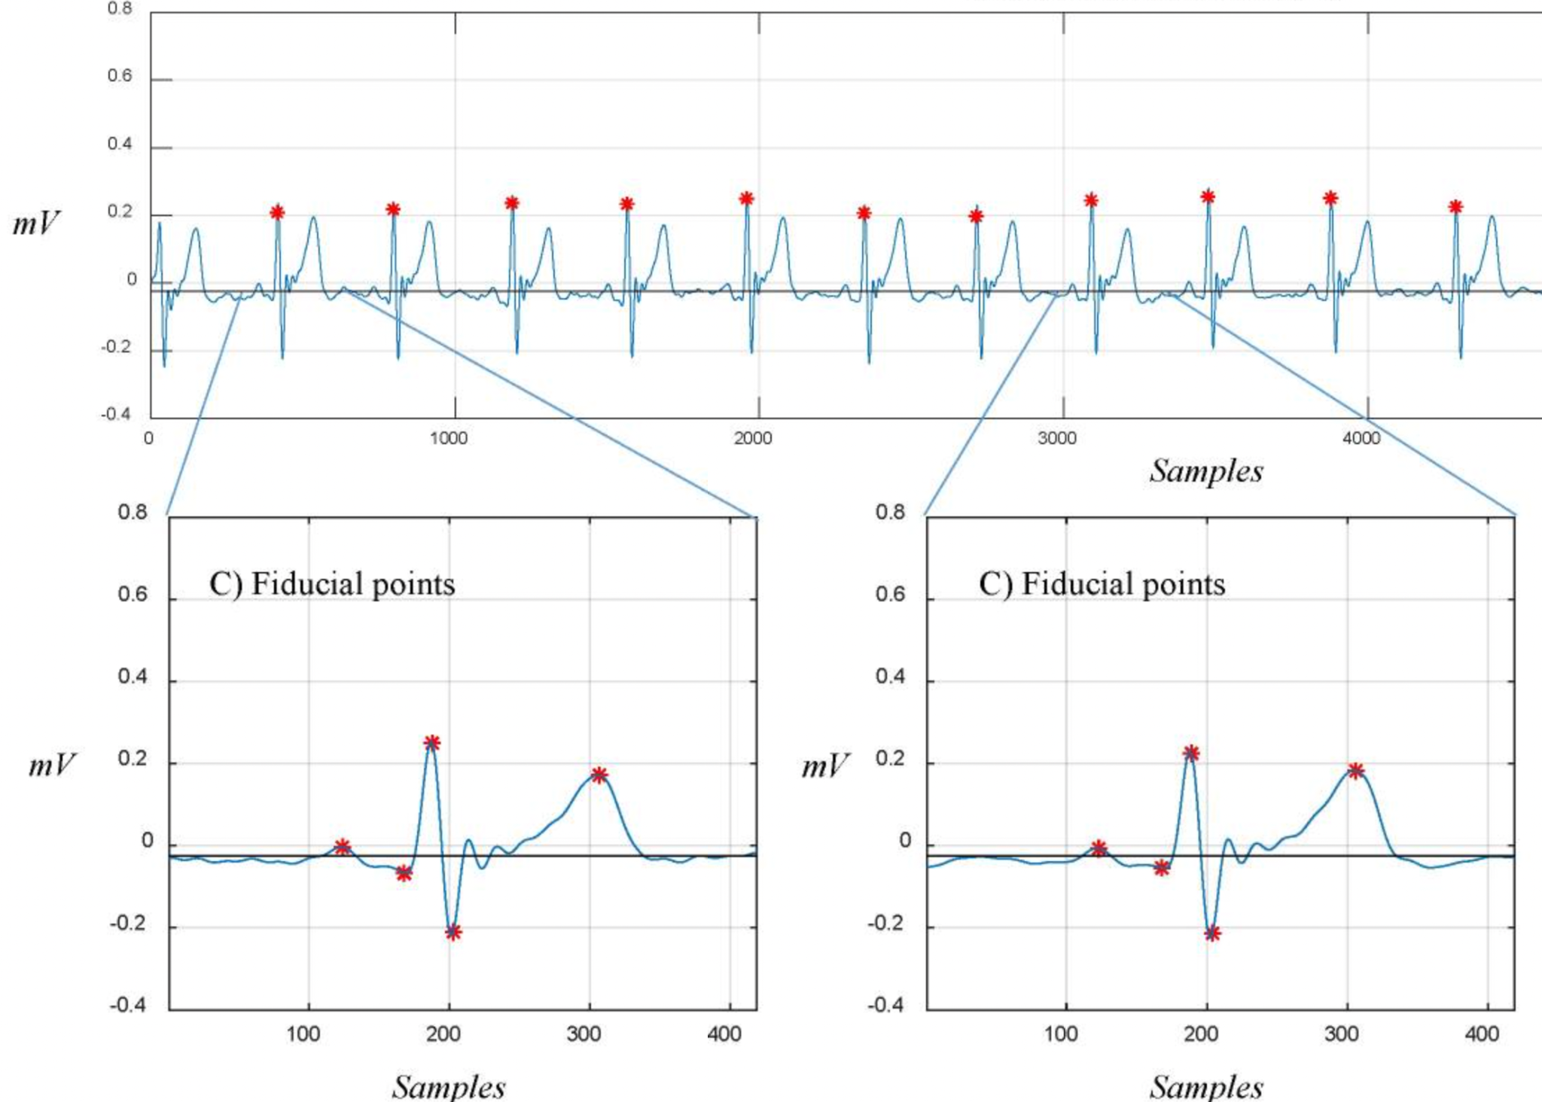
Isometric line fitting the signal for Q peak detection:
R peak detection and segmentation:

Slide 14
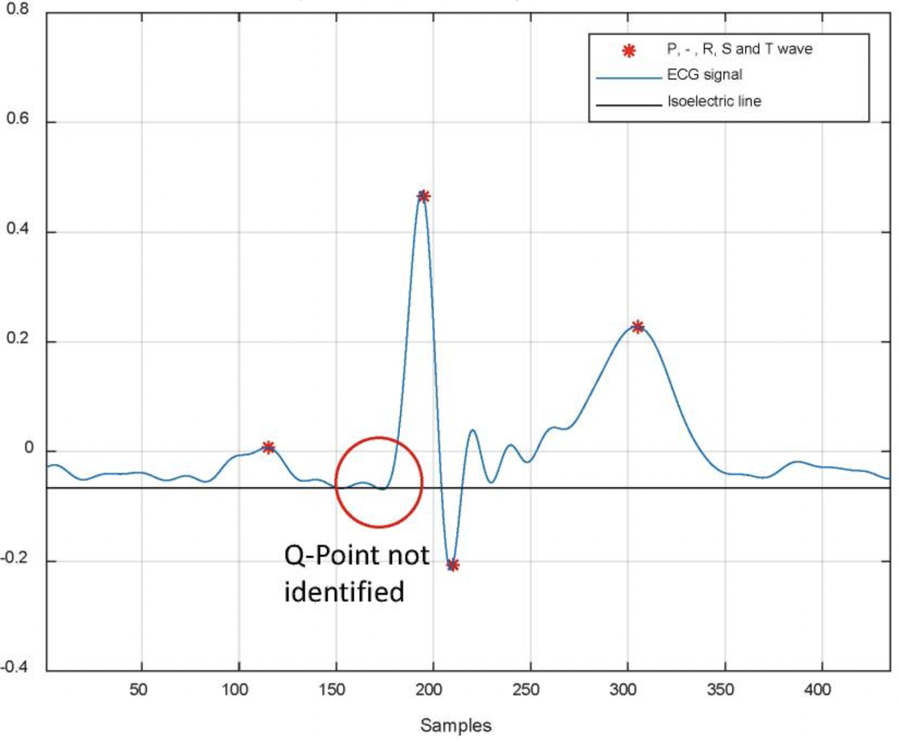
Limitations
In 2.5 % of the cases, the algorithm failed to detect the Q point.
Error caused by closeness between Q- point and isometric line.
Not suitable for every type of ECG signal.

Slide 15
Strategy used
03

Slide 16
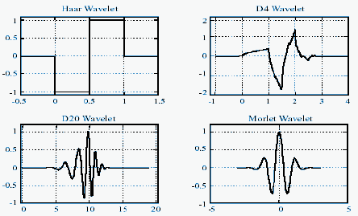
Using wavelets
The accuracy rates of the ECG signals segmented using wavelet transforms is very high comparing to other methods.
There are different types of wavelets - We will use haar wavelet for our algorithm.
https://www.researchgate.net/figure/Different-types-of-wavelets_fig1_254227978

Slide 17
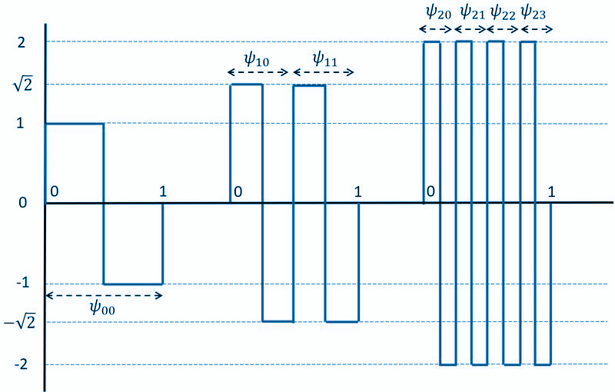
Haar wavelets
Haar wavelets are one of the simplest types of wavelets.
Haar wavelets are numerically stable.
Haar wavelets are well-suited analyzing a signal at different levels of detail. - Multiresolution analysis.
https://www.marinespecies.org/i/images/f/fb/Haar.jpg

Slide 18
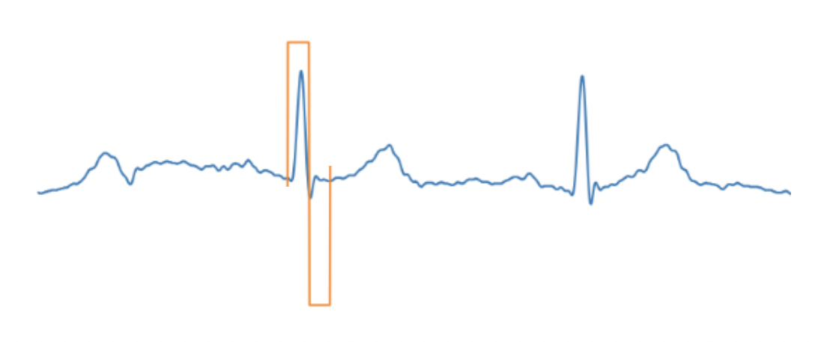
Plot the ECG signal and set the Haar wavelet scale such that its first half (consisting positive 1s) exactly fits the R peak and the next half, the S peak.

Slide 19
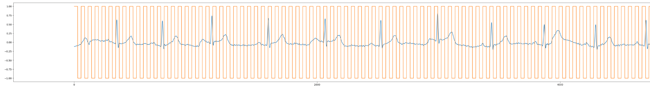
The wavelet function is then convolved with the ECG signal to produce a certain value. We took a continuous stream of haar wavelet to compute convolutions.

Slide 20
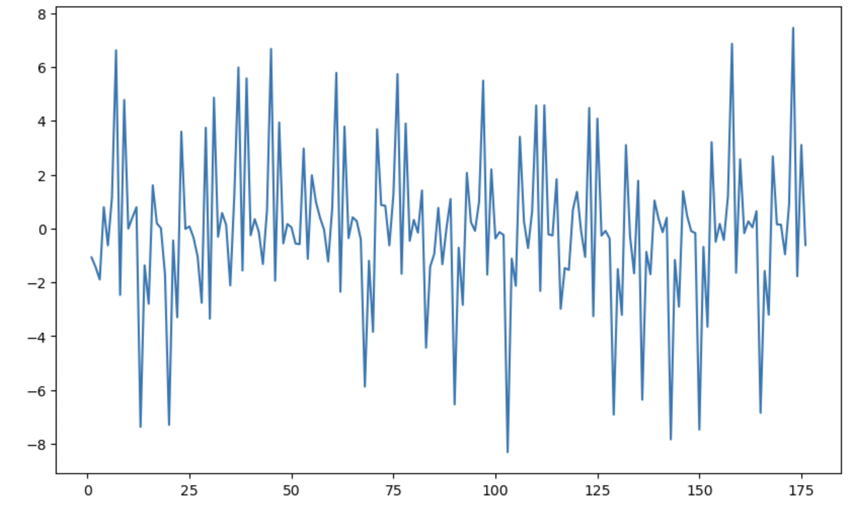
Number of beats in our taken ECG signal | 24
Number of samples for ECG | 10000
Width of Haar wavelet | 28.5 samples
No of values recorded | 10000/28.5 = 175
The convolved values plotted as graph:

Slide 21
Limitation of this approach
The resultant convolution value graph depends so much on the scale of the Haar wavelet used.
The scale needs to be manually entered.

Slide 22
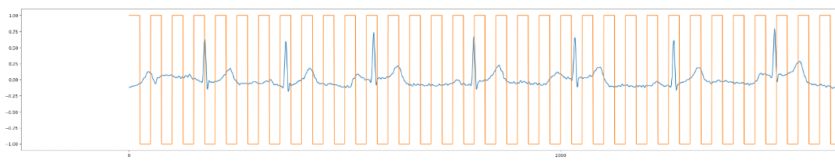
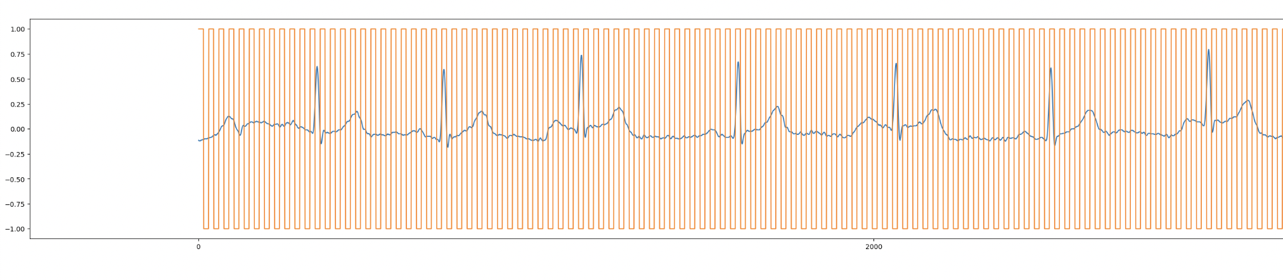
Plot with a greater scale:
Plot with a smaller scale:

Slide 23
The road ahead
Using Discrete Wavelet Transform (DWT)

Slide 24
Using DWT
Automatically picks the scale of the haar wavelet suitable for segmentation - starts from scale of 1 and goes till the desired scale.
No manual intervention - automatic segmentation.

Slide 25
Thank you!
We are up for the questions

Slide 26
References
https://slidesgo.com/search?q=heart+disease
https://archive.physionet.org/physiobank/database/
A. B. Ramli, and P. A. Ahmad, “Correlation analysis for abnormal ECG signal features extraction,” 4th National Conference on Telecommunication Technology
Aspuru J, Ochoa-Brust A, Félix RA, Mata-López W, Mena LJ, Ostos R, Martínez-Peláez R. Segmentation of the ECG Signal by Means of a Linear Regression Algorithm. Sensors (Basel).

